Slide 1
Introduction to Serverless Computing

Slide 2
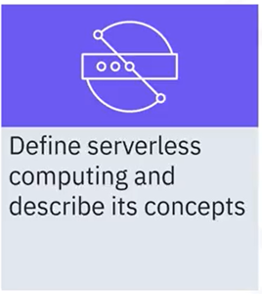
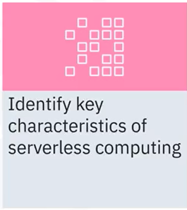
What you will learn

Slide 3
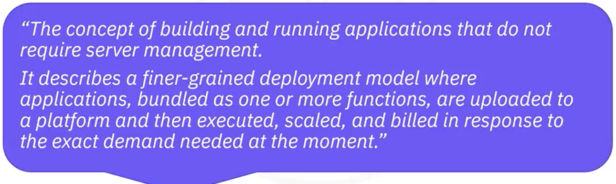
What is serverless computing?
Cloud Native Computing Foundation (CNCF) defines 'serverless'
as:

Slide 4
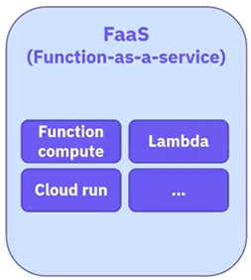
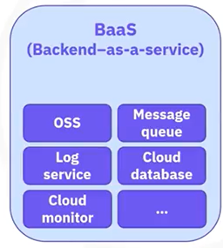
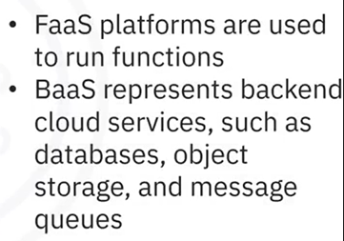
Serverless = FaaS + BaaS
Think of serverless computing as a combination of
FaaS platforms and BasS services

Slide 5




Evolution of serverless computing
progression from traditional to serverless
• Faster deployments
• Shorter lifespans
• Increased productivity

Slide 6

Serverless architecture concepts
• Abstracts infrastructure and software environment
• Code runs in a cloud platform
• Cloud provider manages the hardware and
software setup, security, performance
• Billed only for usage
• Developers only need to focus on applications and
code in the form of functions

Slide 7

Serverless characteristics
• Hostless
• Elastic
• Load balanced
• Stateless
• Event driven
• Highly available
• Usage-based/granular billing

Slide 8
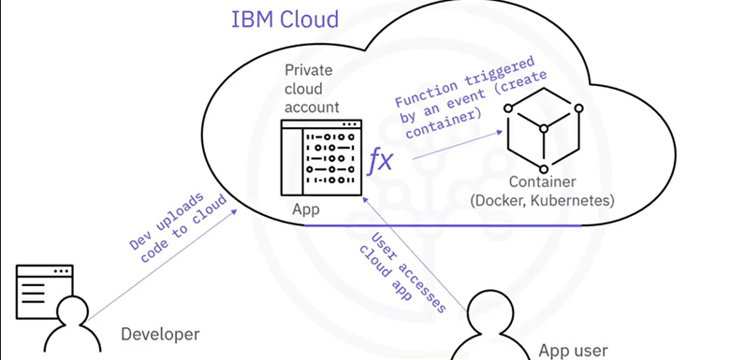
How serverless functions work

Slide 9

Developer's role
Focus on application
development:
• Build functions using a
popular programming
language
• Extend functionality
• Perform better testing
• Optimize apps and
functions
• Improve user experience

Slide 10

Cloud provider responsibilities
• Cloud providers manage common infrastructure and
maintenance tasks such as:
• Maximizing utilization
• Minimizing costs
• Server management
• Autoscaling
• High availability
• Security
• Performance (low latency)
• Monitoring and logging

Slide 11
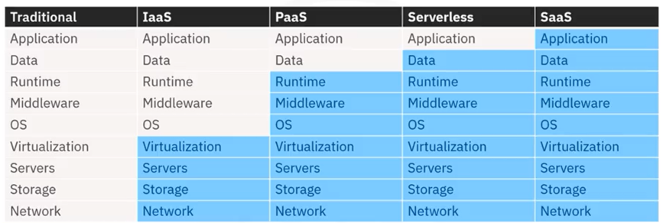

Serverless responsibility model

Slide 12
Recap
In this video, you learned that:
• Serverless is the concept of building and running applications that
do not require server management
• Serverless uses Baas services and FaaS platforms
• IT history shows increased productivity trend from traditional to
serverless computing
• Cloud providers take care of infrastructure management and
maintenance tasks
• Developers can focus on applications and code
• Users billed only for usage and not CPU idle time

